Slide 1

Where should the Response class be located?
In the Survey Class
In the Test Class
In the Question Class
CS 350 – Software Design – Drexel University

Slide 2

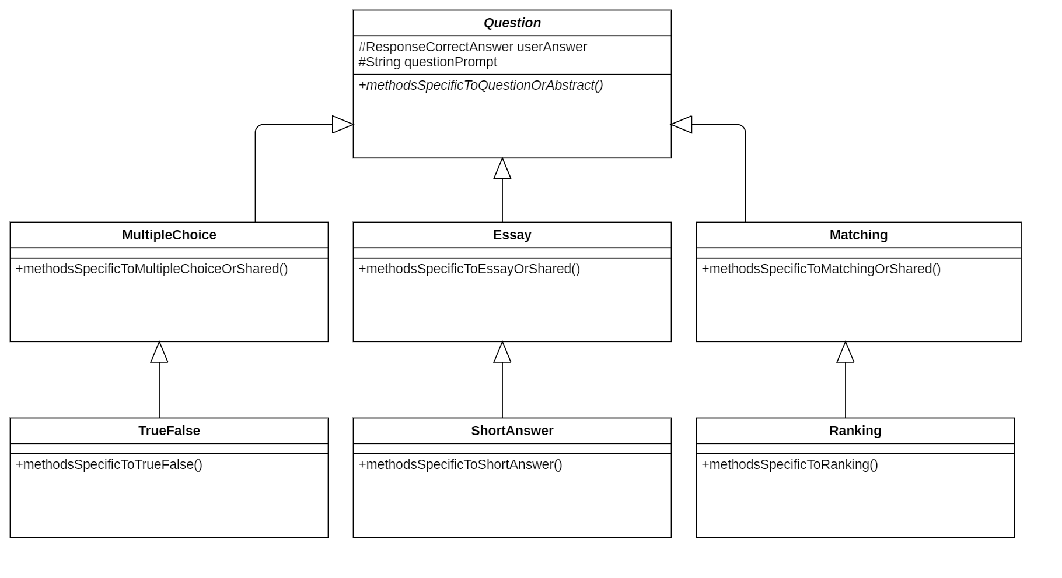
Having an array of responses in Question class is a reasonable solution.
Later, we’ll learn other, more sophisticated ways of handling it.
CS 350 – Software Design – Drexel University

Slide 3

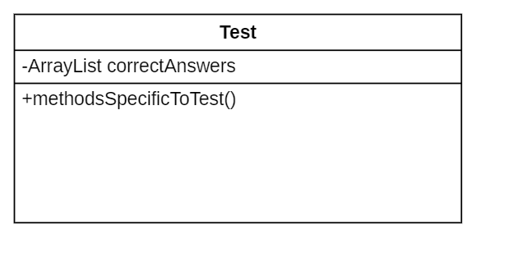
Responses shouldn’t be in the Test class.
They should be either in Survey or Question.
A Test should inherit the behavior of a Response from the Survey class.
Return to the previous question
CS 350 – Software Design – Drexel University

Slide 4
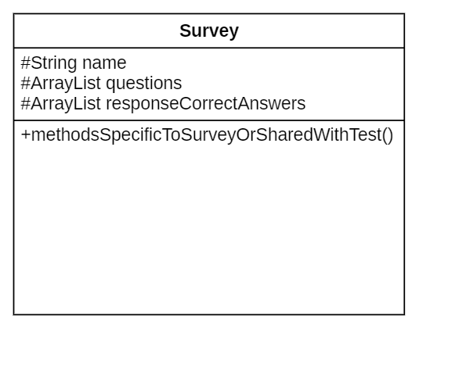
Having an array of responses in Survey is a reasonable solution.
Later, we’ll learn other, more sophisticated ways of handling it.
CS 350 – Software Design – Drexel University

